Slide 1
Natural Gas, a Decarbonized Future, and DOER’s Policy Priorities June 12, 2020
COMMONWEALTH OF MASSACHUSETTS
Patrick Woodcock, Commissioner

Slide 2
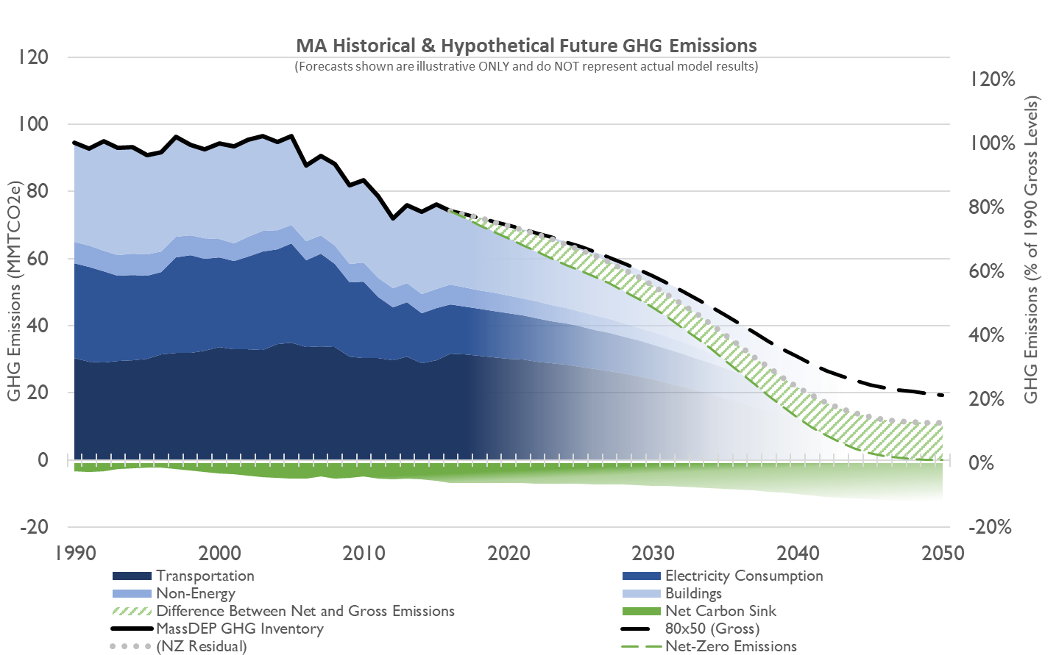
What is Net Zero?

Slide 3
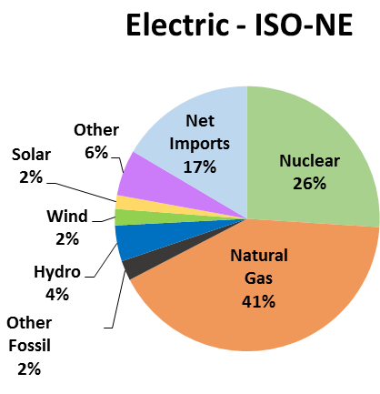
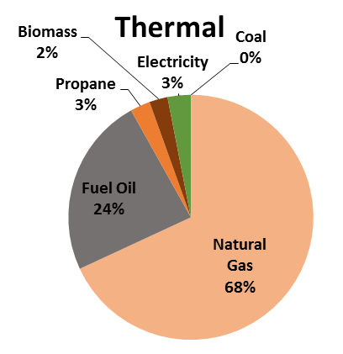
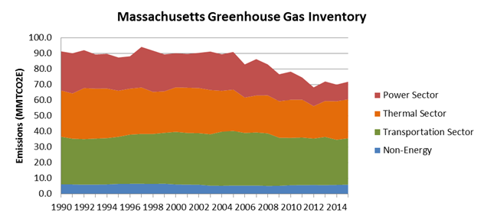
Massachusetts Natural Gas Demand
Source: ISO-NE 2017
Source: EIA 2017
Natural Gas is the predominant fuel in both the electric and thermal sectors
Most emission reductions have come from the electric sector, while the thermal sector has remained relatively flat, despite increases in population and square footage

Slide 4
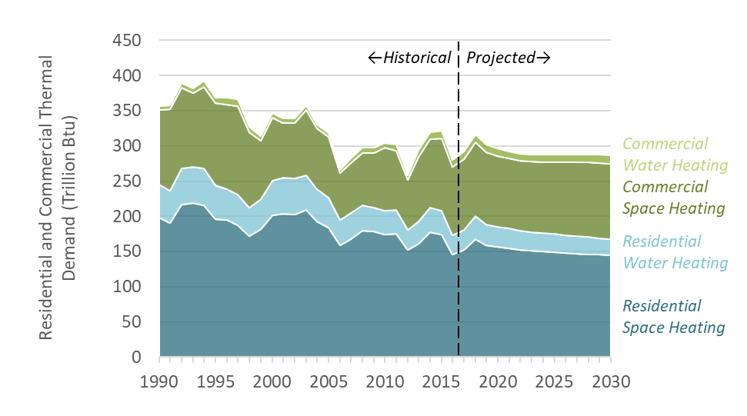
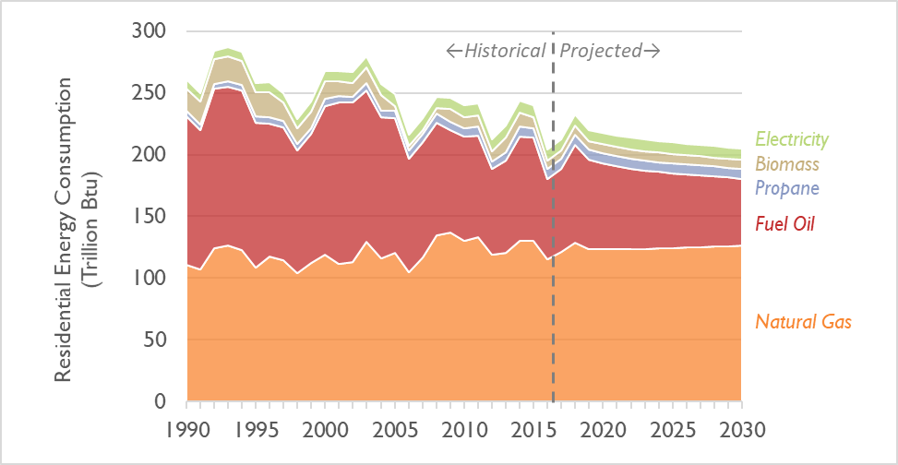
Natural Gas in the Thermal Sector MA Comprehensive Energy Plan 2018 – Sustained Policies Scenario
The Sustained Policies Scenario showed a projected increase in the use of natural gas for residential energy demand, the largest thermal sector. Commercial sector use is projected to increase as well
This is driven in part because of the projected low cost of natural gas as a fuel for heating
Average Residential Customer Cost in 2030 – Sustained Policy Scenario
Promote high efficiency building construction, such as Passive House standards, to further reduce energy demand from the thermal sector
Promote fuel switching in the thermal sector from more expensive, higher carbon fuels to lower cost, lower carbon fuels such as electric air source heat pumps and biofuels
Invest in research and development for clean fuels, such as renewable power-to-gas and hydrogen that can utilize existing infrastructure and contribute to emission reductions

Slide 5
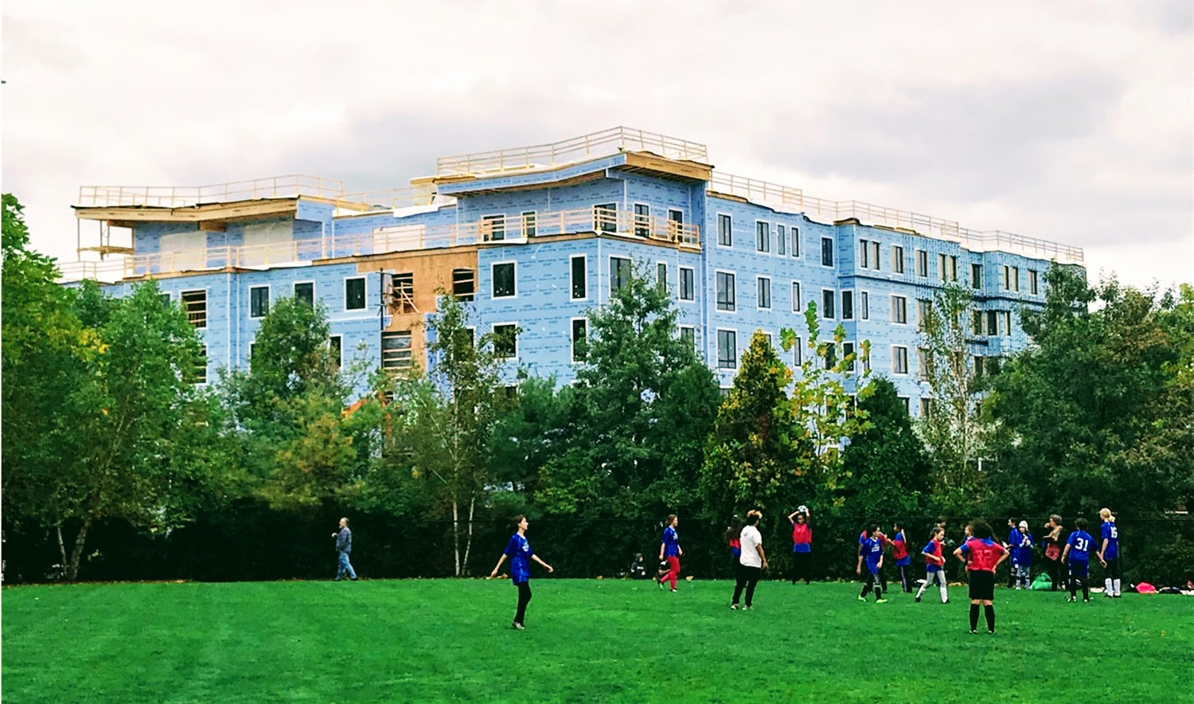
New Construction: High Efficiency + Electrification
Mass Save® Passive House incentives:
Pre-design, energy modelling cost shares
Multi-family $3,000/unit, Low rise coming soon
Training: Classroom, certification testing, webinars
Mass Clean Energy Center grants $4,000/unit, eight projects
Affordable housing: Passive House QAP points for low-income housing tax credits
Renewable thermal (APS) multipliers for Passive House projects
MEPA state greenhouse gas project review: Passive House commitments
Considerations going forward:
Expansion of Passive House strategies for commercial construction
Alignment of incentives and codes
Stretch code transition
Finch Cambridge - 98 Units Affordable
Committed Units in MA
2020
Finch Cambridge - 98 Units Affordable Passive House
2018
4,300 Units
Includes 1,700 affordable
100 Units
Notes:
.

Slide 6
Existing Buildings: Efficiency Paired with Fuel Switching & Strategic Electrification
PAST
PRESENT
FUTURE
Mass CEC Rebates
Mass Save Incentives for customers to fuel switch to air source heat pumps and other renewable heating options
Re-assessing new fossil fuel system incentives
Electrification of gas-heated homes / businesses
Economics for customers
DOER HomeMVP Pilot with performance-based incentives for insulation and heat pumps
MassCEC Whole Home Pilot for full gas to electric conversions

Slide 7
Additional Pathways for Decarbonization
Renewable Natural Gas
Organic waste feedstocks are necessary for lifecycle greenhouse gas emission savings to be realized
There are limits on the availability of renewable natural gas due to the availability of organic waste feedstocks
Combustion of renewable natural gas will still result in greenhouse gas emissions and must be overcome to address Net Zero by 2050 target
Geothermal
Technology is proven but questions remain on the best approach to incorporate into utility model (i.e., rate design, maximize benefits, customer class, etc.)
Hydrogen
Greenhouse gas emission savings are dictated by the source of the electricity used to generate the hydrogen
Existing infrastructure is limited to a 20% blend
Higher costs and safety concerns would need to be addressed for wider distribution
Opportunity for energy storage use at on-site facilities

Slide 8
THANK YOU

